Slide 1
CASE STUDY : AGILE DEVELOPMENT ANALYSIS FOR TINY CORP’S PAYMENT SOLUTION

Slide 2
Introduction
Tiny Corp is a startup focused on enabling businesses to collect recurring payments through our software platform.
User Definitions:
Customers using Tiny Corp’s system to manage payments.
Billing Clients paying Customers through our platform.

Slide 3
Challenge
Unexpected shift: The product roadmap was altered , leading to the discarding of planned work for next 2- 3 weeks.
New priorities:
Loyalty Program allows customers to offer discount based on timely payments from their Billing Clients.
Self-Service Payment Changes empowers Billing Clients to update their payment methods without needing to call support.

Slide 4
Actions Taken : BACCM Framework
Change: Identified the need for new capabilities for both Customers and Billing Clients
Solutions: Loyalty Program for Customers and Self-Service Payment Changes for Billing Clients.
Contexts: Emphasized the urgency of starting software development to maximize efficiency and minimize wasted resources.
Value: Increased satisfaction for Billing Clients. Enhanced product value for Customers and a competitive edge in the market.

Slide 5
Stakeholders: Identified key stakeholders involved in the process:
Product Management
Developers
Customers
Billing Clients
Training Team
User Experience Team
Service Team
Needs:
Internal needs: Improve speed and reduce waste.
Customer needs: Drive retention through the loyalty program. Billing Client needs: Increase convenience with the self-service
payment changes

Slide 6
Gathering Requirements
Elicitation Techniques: Conducted discussions with key stakeholders, including the Product Owner and SMEs, to gather insights and collaborative sessions with the development team and stakeholders.
Documentation Approach: Maintained records of discussions and decisions for future reference, ensuring a historical context for the requirements.
Iterative Process: Planned for ongoing refinement of requirements as the project progressed, allowing for adjustments based on stakeholder feedback and evolving understanding.

Slide 7
User Stories
Self- Service Feature:
1.Updating Payment Method As a Billing Client, I want to update my payment method through a self-service portal, So that I can manage my payments without needing to call customer support. Acceptance Criteria: The portal allows users to add, remove, and edit payment methods.
Loyalty Program
1.Setting up a loyalty program : As a Customer, I want to set up a loyalty program for my Billing Clients, so that they can receive discounts for making 6 consecutive on-time, successful payments.

Slide 8
Acceptance Criteria:
When a Billing Client reaches 6 consecutive on-time payments, they automatically receive the defined discount.

Slide 9
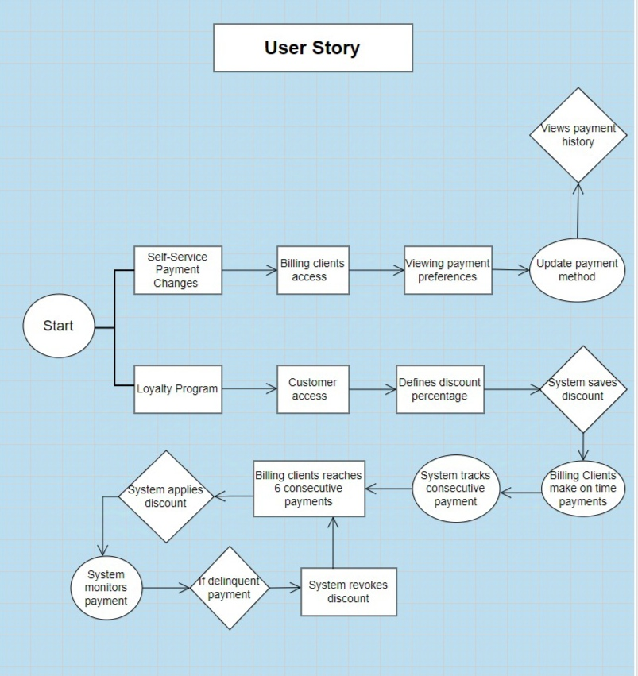
Flow Diagram of User Story

Slide 10
Sprint Overview
Sprint 1 (Weeks 1-2) :Initial development of Self-Service features. Sprint 2 (Weeks 3-4): Finalize Self-Service features and start initial work on Loyalty Program. Sprint 3 (Weeks 5-6): Complete Loyalty Program setup and enhancements. Sprint 4 (Weeks 7-8):Finalize any remaining Loyalty Program features and begin analysis for the next feature. Sprint 5 (Weeks 9-10):Focus: Identify new features and address any critical bugs.

Slide 11
Testing and Quality Assurance
Unit Testing: Ensure individual components of the self-service and loyalty features function correctly.
Integration Testing: Test interactions between new features and existing systems to ensure they work seamlessly together.
User Acceptance Testing (UAT): Engage stakeholders and selected Billing Clients to validate that the features meet their needs and expectations

Slide 12
Conclusion
Project Overview: Successfully developed and launched features aimed at enhancing user experience for both Customers and Billing Clients.
Successful Implementation: Launched the Self-Service feature, allowing Billing Clients to manage their payment preferences independently.Introduced a Loyalty Program that incentivizes on-time payments, boosting retention for our Customers.

